Slide 1
Finite Automaton with output
Finite automaton discussed so far, is just associated with the RE or the language.
There is a question whether does there exist an FA which generates an output string corresponding to each input string ? The answer is yes. Such machines are called machines with output.
There are two types of machines with output. Moore machine and Mealy machine

Slide 2
Moore machine
A Moore machine consists of the following
  A finite set of states q₀, q₁, q₂, … where q₀ is the initial state.
  An alphabet of letters Σ = {a,b,c,…} from which the input strings are formed.
  An alphabet Γ ={x,y,z,…} of output characters from which output strings are generated.

Slide 3
Moore machine continued …
4. A transition table that shows for each state and each input letter what state is entered the next.
5. An output table that shows what character is printed by each state as it is entered.

Slide 4
Moore machine continued …
Note: It is to be noted that since in Moore machine no state is designated to be a final state, so there is no question of accepting any language by Moore machine. However in some cases the relation between an input string and the corresponding output string may be identified by the Moore machine. Moreover, the state to be initial is not important as if the machine is used several times and is restarted after some time, the machine will be started from the state where it was left off. Following are the examples

Slide 5
Example
Consider the following Moore machine having the states q₀, q₁, q₂, q₃ where q₀ is the start state and
Σ = {a,b},
Γ ={0,1}
the transition table follows as

Slide 6
Example continued …
Old States | New States after reading
 | a | b
q₀- | q₁ | q₃
q₁ | q₃ | q₁
q₂ | q₀ | q₃
q₃ | q₃ | q₂
Characters to be printed
1
0
0
1

Slide 7
Example continued …
the transition diagram corresponding to the previous transition table may be
b
q₀/1
a
q₁/0
b
a
a
b
q₂/0
q₃/1
a
b

Slide 8
Example continued …
b
It is to be noted that the states are labeled along with the characters to be printed. Running the string abbabbba over the above machine, the corresponding output string will be 100010101, which can be determined by the following table as well
q₀/1
a
q₁/0
b
a
a
b
q₂/0
q₃/1
a
b

Slide 9
Example continued …
It may be noted that the length of output string is l more than that of input string as the initial state prints out the extra character 1, before the input string is read.
Input
a
b
b
a
b
b
b
a
State
q₀
q₁
q₁
q₁
q₃
q₂
q₃
q₂
q₀
output
1
0
0
0
1
0
1
0
1

Slide 10
Example
To identify the relation between the input strings and the corresponding output strings in the following Moore machine,
a
a
b
b
q₂/0
a
q₀/0
q₁/0
q₃/1
a
b
b

Slide 11
Example continued …
if the string bbbabaabbaa is run, the output string will be 000010000010, as shown below
Input
b
b
b
a
b
a
a
b
b
a
a
State
q₀
q₁
q₂
q₂
q₃
q₁
q₀
q₀
q₁
q₂
q₃
q₀
output
0
0
0
0
1
0
0
0
0
0
1
0

Slide 12
Example continued …
It can be observed from the given Moore machine that q₃ is the only state which prints out the character 1 which shows that the moment the state q₃ is entered, the machine will print out 1. To enter the state q₃, starting from q₀ the string must contain bba. It can also be observed that to enter the state q₃ once more the string must contain another substirng bba. In general the input string will visit the state q₃ as many times as the number of substring bba occurs in the input string. Thus the number of 1’s in an output string will be same as the number of substring bba occurs in the corresponding input string.

Slide 13
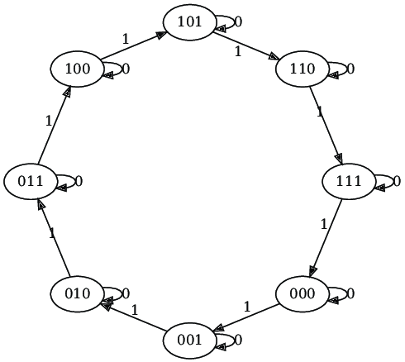
Moore Machine for counter

Slide 14
Mealy machine
A Mealy machine consists of the following
  A finite set of states q₀, q₁, q₂, … where q₀ is the initial state.
  An alphabet of letters Σ = {a,b,c,…} from which the input strings are formed.
  An alphabet Γ ={x,y,z,…} of output characters from which output strings are generated.

Slide 15
Mealy machine continued …
4. A pictorial representation with states and directed edges labeled by an input letter along with an output character. The directed edges also show how to go from one state to another corresponding to every possible input letter.
Note: It is not possible to give transition table in this case.

Slide 16
Mealy machine continued …
Note: It is to be noted that since, similar to Moore machine, in Mealy machine no state is designated to be a final state, so there is no question of accepting any language by Mealy machine. However in some cases the relation between an input string and the corresponding output string may be identified by the Mealy machine. Moreover, the state to be initial is not important as if the machine is used several times and is restarted after some time, the machine will be started from the state where it was left off. Following are the examples

Slide 17
Example
Consider the following Mealy machine having the states q₀, q₁, q₂, q₃ , where q₀ is the start state and
Σ = {a,b},
Γ ={0,1}
q₁
b/1
q₂
a/0
a/0
a/1
b/1
q₀
b/0
q₃
a/1
b/1

Slide 18
q₁
1/b
q₂
1/a
0/a
0/a
1/b
q₀
0/b
q₃
1/a
1/b

Slide 19
Example continued …
q₁
b/1
q₂
Running the string abbabbba over the above machine, the corresponding output string will be 01111010, which can be determined by the following table as well
a/0
a/0
a/1
b/1
b/0
q₀
q₃
a/1
b/1

Slide 20
Example continued …
It may be noted that in Mealy machine, the length of output string is equal to that of input string.
Input
a
b
b
a
b
b
b
a
States
q₀
q₁
q₂
q₃
q₃
q₀
q₃
q₀
q₁
output
0
1
1
1
1
0
1
0

Slide 21
Example
Consider the following Mealy machine having the states q₀, q₁, q₂ , where q₀ is the start state and
Σ = {a,b},
Γ ={0,1}
b/0
a/1
q₁
q₂
b/1
a/0
a/0
b/0
q₀

Slide 22
Example continued …
It is observed that in the above Mealy machine, if in the output string the nth character is 1, it shows that the nth letter in the input string is the second in the pair of double letter.
For babaababba as input string the machine will print 0000100010.

Slide 23
Theorem
Statement:
For every Moore machine there is a Mealy machine that is equivalent to it (ignoring the extra character printed by the Moore machine).
Proof: Let M be a Moore machine, then shifting the output characters corresponding to each state to the labels of corresponding incoming transitions, machine thus obtained will be a Mealy machine equivalent to M.
Following is a note

Slide 24
Note
It may be noted that while converting a Moore machine into an equivalent Mealy machine, the output character of a state will be ignored if there is no incoming transition at that state. A loop at a state is also supposed to be an incoming transition.
Following is the example of converting a Moore machine into an equivalent Mealy machine

Slide 25
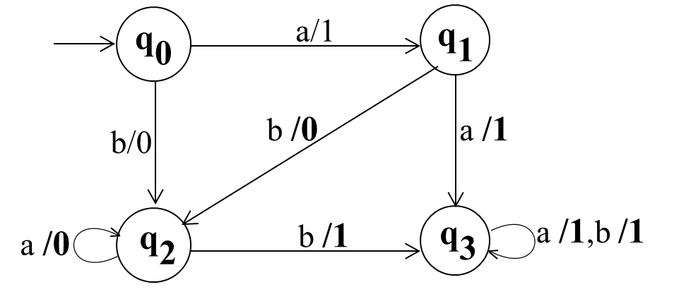
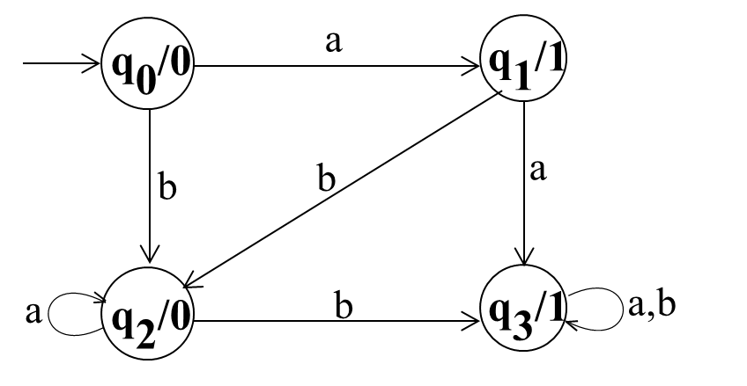
Example
Consider the following Moore machine
Using the method described earlier, the above machine may be equivalent to the following Mealy machine

Slide 26
Example continued ...
q₀
a/1
q₁
b/0
b /0
a /1
a /0
q₂
b /1
q₃
a /1,b /1
Running the string abbabbba on both the machines, the output string can be determined by the following table

Slide 27
Example continued ...
Input
a
b
b
a
b
b
b
a
States
q₀
q₁
q₂
q₃
q₃
q₃
q₃
q₃
q₃
Moore
0
1
0
1
1
1
1
1
1
Mealy
1
0
1
1
1
1
1
1

Slide 28
Theorem
Statement:
For every Mealy machine there is a Moore machine that is equivalent to it (ignoring the extra character printed the Moore machine).
Proof: Let M be a Mealy machine. At each state there are two possibilities for incoming transitions
  The incoming transitions have the same output character.
  The incoming transitions have different output characters.

Slide 29
Proof continued …
If all the transitions have same output characters, then shift that character to the corresponding state.
If all the transitions have different output characters, then the state will be converted to as many states as the number of different output characters for these transitions, which shows that if this happens at state q_{i} then q_{i} will be converted to q_{i}¹ and q_{i}² i.e. if at q_{i} there are the transitions with two output characters then q_{i}¹ for one character and q_{i}² for other character.

Slide 30
Proof continued …
Shift the output characters of the transitions to the corresponding new states q_{i}¹ and q_{i}². Moreover, these new states q_{i}¹ and q_{i}² should behave like q_{i} as well. Continuing the process, the machine thus obtained, will be a Moore machine equivalent to Mealy machine M.
Following is a note

Slide 31
Note
It may be noted that if there is no incoming transition at certain state then any of the output characters may be associated with that state.
It may also be noted that if the initial state is converted into more than one new states then only one of these new states will be considered to be the initial state. Following is an example

Slide 32
Example
Consider the following Mealy machine
q₁
b/1
q₂
a/0
a/0
a/1
b/1
q₀
b/0
q₃
a/1
b/1

Slide 33
Example continued ...
Shifting the output character 1 of transition b to q₀
q₁
b/1
q₂
a/0
a/0
a/1
b/1
b/0
q₃
q₀/1
a/1
b

Slide 34
Example continued ...
Shifting the output character 0 of transition a to q₁
b/1
q₂
q₁/0
a/0
a
a/1
b/1
b/0
q₃
q₀/1
a/1
b

Slide 35
Example continued ...
Shifting the output character 1 of transition b to q₂
q₁/0
b
q₂/1
a/0
a
a/1
b/1
b/0
q₃
q₀/1
a/1
b

Slide 36
Example continued ...
Splitting q₃ into q₃ and q₃
q₁/0
b
q₂/1
1
2
a
b
a
q₀/1
a
b
a
1
q₃/1
b
b
a
2
q₃/0

Slide 37
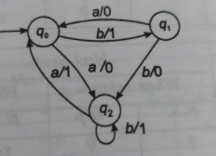
Example

Slide 38
Theorem
Statement:
For every Mealy machine there is a Moore machine that is equivalent to it (ignoring the extra character printed the Moore machine).

Slide 39
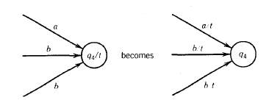
Steps

Slide 40
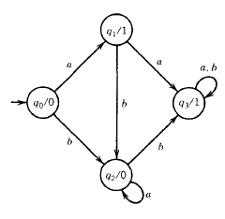
EXAMPLE

Slide 41
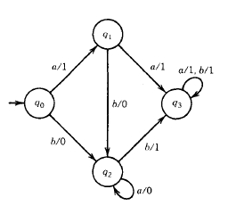
Solution

Slide 42
Example
Consider the following Mealy machine having the only state q₀ as the start state and
Σ = {0,1},
Γ = {0,1}
If 0011010 is run on this machine then the corresponding output string will be 1100101.
This machine is also called Complementing machine.
0/1, 1/0
q₀

Slide 43
Constructing the incrementing machine
In the previous example of complementing machine, it has been observed that the input string and the corresponding output string are 1’s complement of each other. There is a question whether the Mealy machine can be constructed, so that the output string is increased, in magnitude, by 1 than the corresponding input string ? The answer is yes.
This machine is called the incrementing machine. Following is how to construct the incrementing machine

Slide 44
Constructing the incrementing machine continued …
Before the incrementing machine is constructed, consider how 1 is added to a binary number.
Since, if two numbers are added, the addition is performed from right to left, so while increasing the binary number by 1, the string (binary number) must be read by the corresponding Mealy machine from right to left, and hence the output string (binary number) will also be generated from right to left.

Slide 45
Constructing the incrementing machine continued …
  Consider the following additions
  a) 100101110 b) 1001100111
  + 1 + 1
  100101111 1001101000
  It may be observed from the above that
  a) If the right most bit of binary number, to be incremented, is 0, the output binary number can be obtained by converting the right most bit to 1 and remaining bits unchanged.

Slide 46
Constructing the incrementing machine continued …
b) If the right most bit of binary number is 1 then the output can be obtained, converting that 1 along with all its concatenated 1’s to 0’s, then converting the next 0 to 1 and remaining bits unchanged.
The observations (a) and (b) help to construct the following Incrementing (Mealy) machine.

Slide 47
Constructing the incrementing machine continued …
The Mealy machine have the states
q₀, q₁, q₂ , where q₀ is the start state and
Σ = {0,1},
Γ ={0,1}
No Carry
Carry
0/0, 1/1
q₂
q₁
0/1
1/0
0/1
1/0
q₀

Slide 48
Constructing the incrementing machine continued …
It may be observed that, in the incrementing machine, if 0 is read at initial state q₀, that 0 is converted to 1 and a no change state q₁ (no carry state) is entered where all 0’s and all 1’s remain unchanged. If 1 is read at initial state, that 1 is converted to 0 and the state q₂(owe carry state) is entered, where all 1’s are converted to 0’s and at that state if 0 is read that 0 is converted to 1 and the machine goes to no change state.
If the strings 100101110 and 1001100111 are run over this machine, the corresponding output strings will be 100101111 and 1001101000 respectively.

Slide 49
Note
It is to be noted that if the string 111111 is run over the incrementing machine, the machine will print out 000000, which is not increased in magnitude by 1. Such a situation is called an overflow situation, as the length of output string will be same as that of input string.
It may also be noted that there exists another incrementing machine with two states.

Slide 50
Solution of the Task
Incrementing machine with two states
0/0, 1/1
q₁
0/1
q₀
1/0

Slide 51
Applications of Incrementing and Complementing machines
1’s complementing and incrementing machines which are basically Mealy machines are very much helpful in computing.
The incrementing machine helps in building a machine that can perform the addition of binary numbers.
Using the complementing machine along with incrementing machine, one can build a machine that can perform the subtraction of binary numbers.

